Slide 1

Employee Attrition Analysis
A Data-Driven Strategic Framework for Retention
STRATEGIC INSIGHTS & RECOMMENDATIONS

Slide 2
Project Foundation
Scope, Objectives, and Analytical Methodology

Slide 3
Objectives and Core Deliverables
Analysis Goals
Final Deliverables
Identify the most dominant contributing factors governing turnover.
Data Dictionary: Structural baseline of all clinical features.
Analyze attrition across different demographic and operational segments.
EDA Report: Comprehensive exploratory analysis.
Provide data-backed business recommendations to reduce attrition.
Dashboard: Interactive Tableau visualization suite.

Slide 4





Data Engineering Workflow
Cleaning
Identification
Schema
Removed null values and duplicates. Eliminated zero-variance columns to ensure high-fidelity insights.
Categorized 23 numerical and 8 categorical features. Audited data for logical contradictions.
Synthesized a robust data dictionary mapping types, null counts, and unique value distributions.

Slide 5
Exploratory Data Analysis
Quantifying the State of the Workforce

Slide 6
Workforce KPI Snapshot
1,470
16.12%
$6,503
TOTAL ROSTER
ATTRITION RATE
AVG. INCOME
A significant 16.12% baseline attrition rate indicates a critical need for targeted retention strategies across high-risk employee segments.

Slide 7
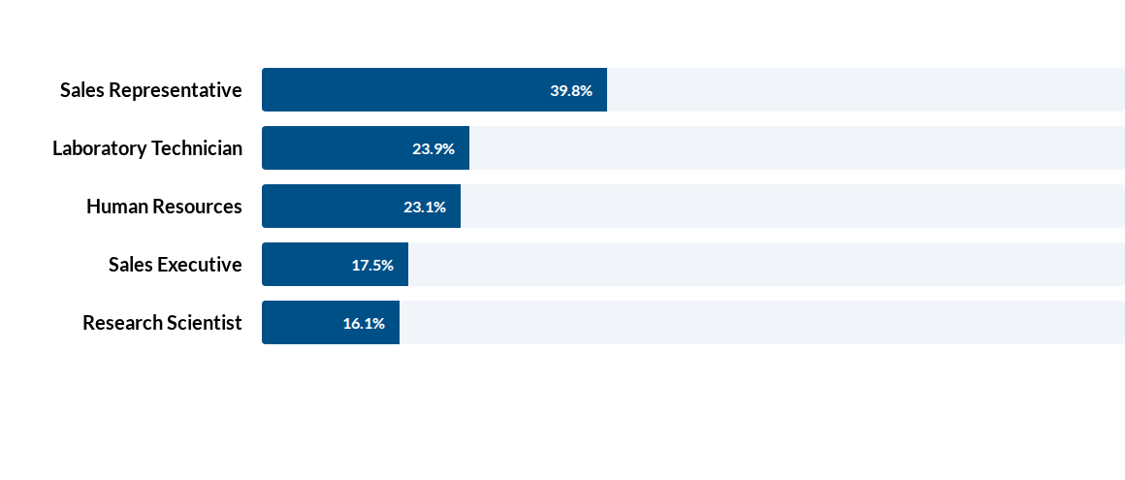
Attrition Rate by Job Role
Sales Representatives show the highest attrition velocity, nearly 2.5x the organizational baseline.

Slide 8


The Overtime Retention Trigger
Burnout Analysis
Overtime is the single most aggressiveOperational catalyst for turnover.
OT Attrition: 30.53%
Non-OT Attrition: 10.44%
Excessive hours are creating a high-risk flight zone for nearly 1/3 of the overtime cohort.

Slide 9
The Compensation Disparity Gap
Employee Cohort | Avg. Monthly Income | Income Differential
Retained Employees | $6,832.74 | Baseline
Departed Employees | $4,787.09 | - 29.9%
Job Level 2 (OT Focus) | $4,534.00 | Critical Gap
There is a nearly 30% pay gap between those who stay and those who leave, identifying salary as a primary motivator for migration.

Slide 10
Interactive Visualization
Optimizing the Strategic Dashboard Interface

Slide 11

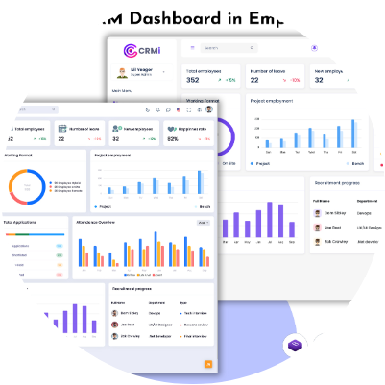
Visual Layout Optimization
UI/UX Improvements
Resolved the "Income Disparity Problem" identified in initial critiques by optimizing container dimensions.
Fixed Truncation: Increased vertical padding to reveal cut-off X-axis labels.
Improved Readability: Ensured Job Levels 2, 3, and 4 are fully visible.
Cross-Filtering: Validated dynamic action filters for Job Role focus.

Slide 12





Strategic Recommendations
Cap Overtime
Restructure Pay
Target Single Segment
Implement an automated audit for departments logging >15% overtime to prevent the 30% attrition spike.
Correct the Job Level 2 pay paradox where high labor output is not meeting market-rate compensation.
Develop fast-tracked development paths for single employees who show a 25.5% flight risk velocity.

Slide 13


Image Sources
https://static.vecteezy.com/system/resources/previews/062/740/377/large_2x/african-american-man-working-at-trading-desk-at-night-monitoring-forex-charts-on-multiple-monitors-black-male-employee-working-late-in-brick-wall-office-reviewing-stock-market-growth-in-real-time-photo.jpg
Source: www.vecteezy.com
https://multipurposethemes.com/wp-content/uploads/2026/03/HRM-Dashboard.jpg
Source: multipurposethemes.com

